Slide 1

Power Apps Makeover: Basic to Beautiful
April Dunnam

Slide 2
Agenda
What makes a beautiful app
Tips to makeover your apps
Demos
Resources
Q&A

Slide 3



April Dunnam
aprildunnam.com
@aprildunnam
youtube.com/c/aprildunnam
Partner Technical Architect, Microsoft

Slide 4
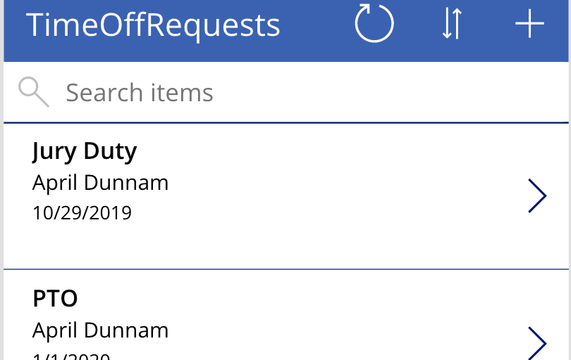
Art of the Possible
Basic

Slide 5
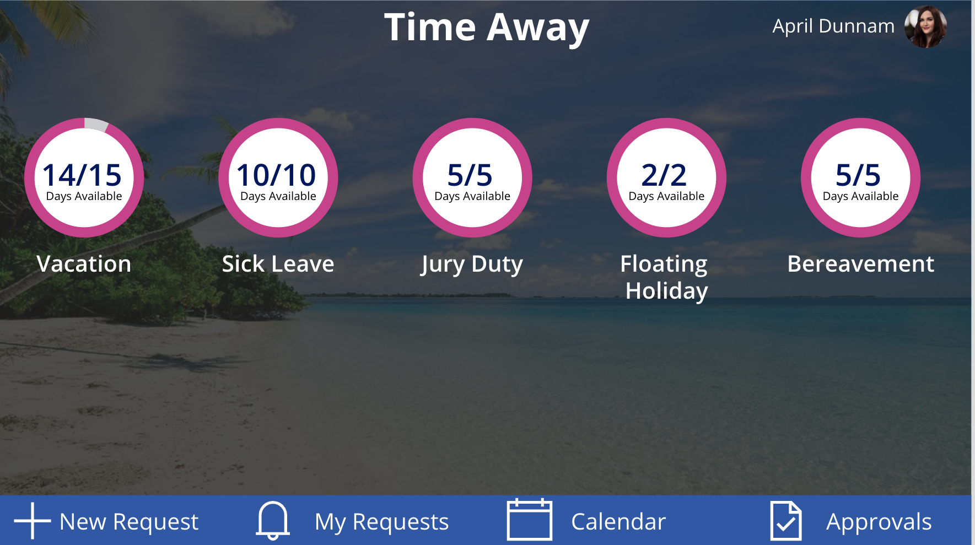
Art of the Possible
Beautiful

Slide 6
What makes a beautiful app?
Branding
User Experience
Performance

Slide 7
What is User Experience
Easy to Use
Accessible
Efficient
Effective
Engaging

Slide 8
Know your problem & audience
Why?
Clearly define the problem you’re trying to solve
Where?
Inside or Outside? (maybe you need dark mode)
In a WIFI hotspot or service dead zone? (might need to design for offline mode)
How?
PC, Table or Phone
Integrations - Teams or SharePoint
Who?
Diverse Geographies? Multilingual support might be needed
Hearing or Vision issues? Accessibility is key

Slide 9
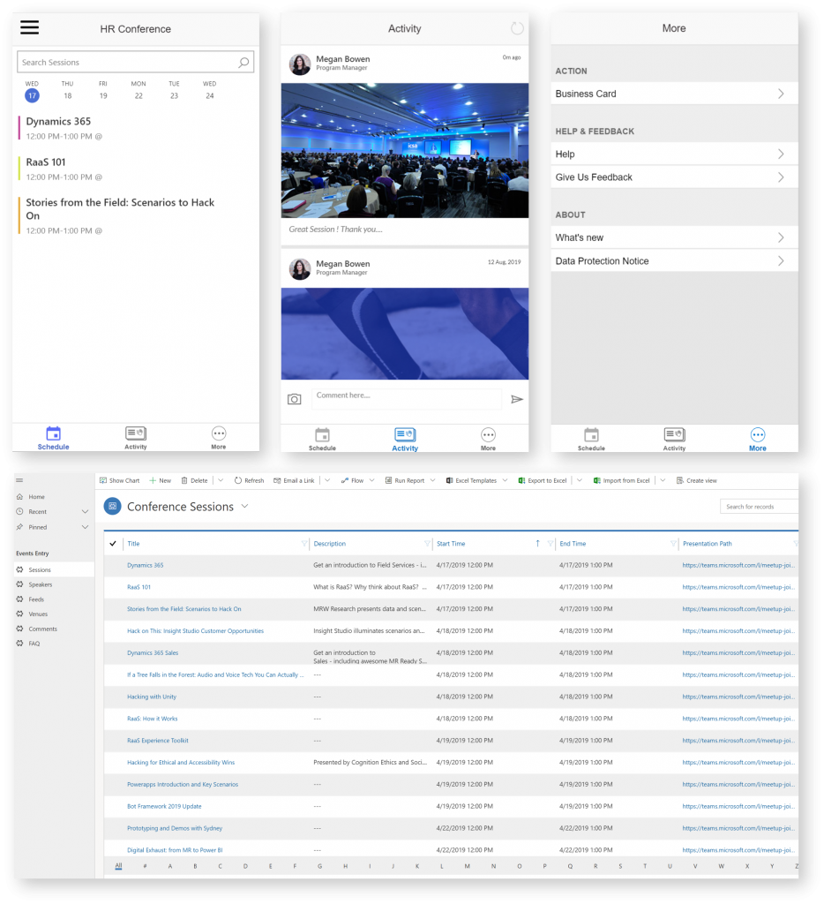
Get Inspired
Microsoft PowerApps Templates
Crisis Communication App
Customer Success
Asset Checkout
Suggestion Box
Power Users Community Samples
Microsoft Employee Experience Starter Kit
UIMovement.com
https://www.pinterest.com/mosier716/app-ui-design-inspiration/
#PowerAddicts
Geetha(@GSiVed), Yusuf(@YusufShariff), Alan(@AlanChai), Sancho (@iAM_ManCat)

Slide 10
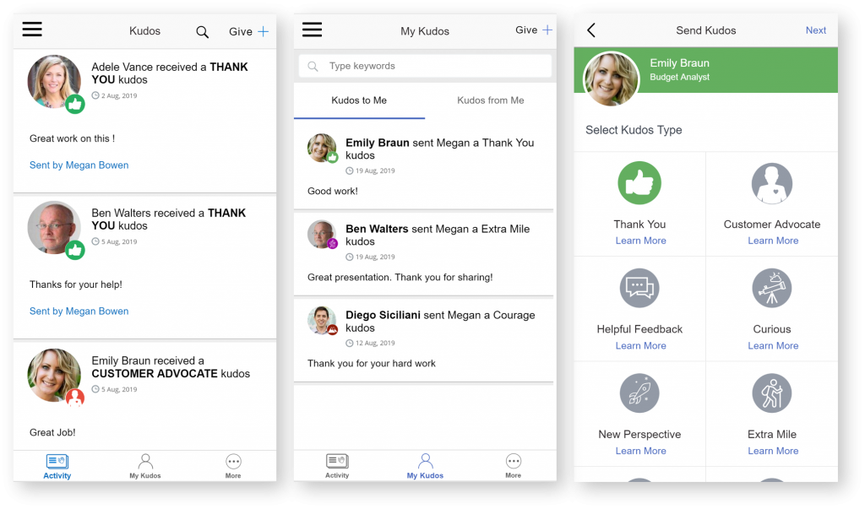
Marie Kondo Your Apps
<<
Clutter is the enemy of good design!
<<
— April Dunnam
Clutter-reducing app hacks
Tabs to reduce scrolling
Popout Menus
More Visuals, less text (SVGs, Icons, etc)
Components for reusability

Slide 11

What are Components?
Reusable building blocks
Define a set of controls
Import components in other apps
Master-Child Implementation

Slide 12

Why Use Components?
Reusability
Consistency
Performance
Collaborative Development

Slide 13
Component Properties
Input
Output
Send information to the component
Color
Text to show
Navigation items to Display
Get information from the component
Selected Item in a Gallery

Slide 14


Remember your ABC’s
Always Be Communicating!
Loading messages for long running processes
Success messages
Error Handling

Slide 15
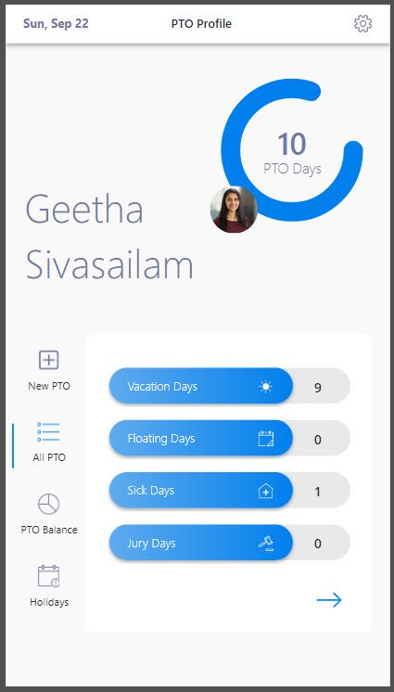
Use the HTML Control
Gives you more flexibility
Box shadows
Text shadows
Gradients
Add CSS to your text
HTML/CSS Generator Tools:
Html-online.com & Html-css-js.com Video: Top 3 Uses for the HTML Control https://youtu.be/HqsV8dO1OBM

Slide 16
The Importance of Performance

Slide 17
PowerApps Loading Process
Authentication
Metadata Retrieval
(Data Sources, Version)
Run OnStart Code
Render Screens

Slide 18
Performance Tips
CACHING IS YOUR FRIEND!
Concurrent Function
BE MINDFUL OF DEPENDENCIES
Reduce code duplication
Try the Performance Checker

Slide 19
Performance

Slide 20
Additional Resources
Power Users Community App Samples
https://powerusers.microsoft.com/t5/Community-App-Samples/bd-p/AppFeedbackGallery
Microsoft Component Examples: https://bit.ly/33s5iJU
Power Users Community Component Samples
https://powerusers.microsoft.com/t5/Canvas-Apps-Components-Samples/bd-p/ComponentsGallery
Free GIFS & SVGS: https://loading.io
Power Users Video Gallery
https://powerusers.microsoft.com/t5/Webinars-and-Video-Gallery/bd-p/VideoGallery
Contrast Checker: https://webaim.org/resources/contrastchecker/
Color Blindness Simulator: https://www.color-blindness.com/coblis-color-blindness-simulator/
Background Images: https://www.pexels.com
Image Compressor: https://compressor.io/
April’s Github with PowerApps Samples: https://github.com/aprildunnam/PowerApps
April’s YouTube: https://youtube.com/c/aprildunnam
April’s Blog: https://www.aprildunnam.com

